Slide 1
Digital Homeworking Human Experience
Mark Holgate
Deployment Architect

Slide 2
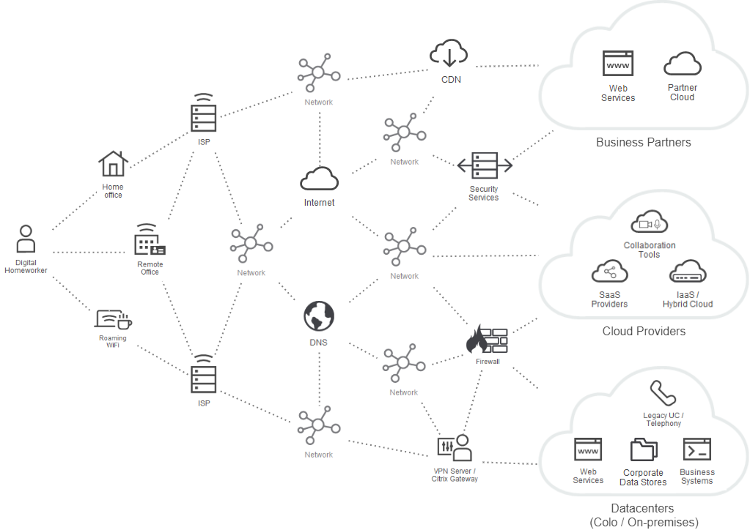


DIGITAL HOMEWORKING
Overview

Slide 3
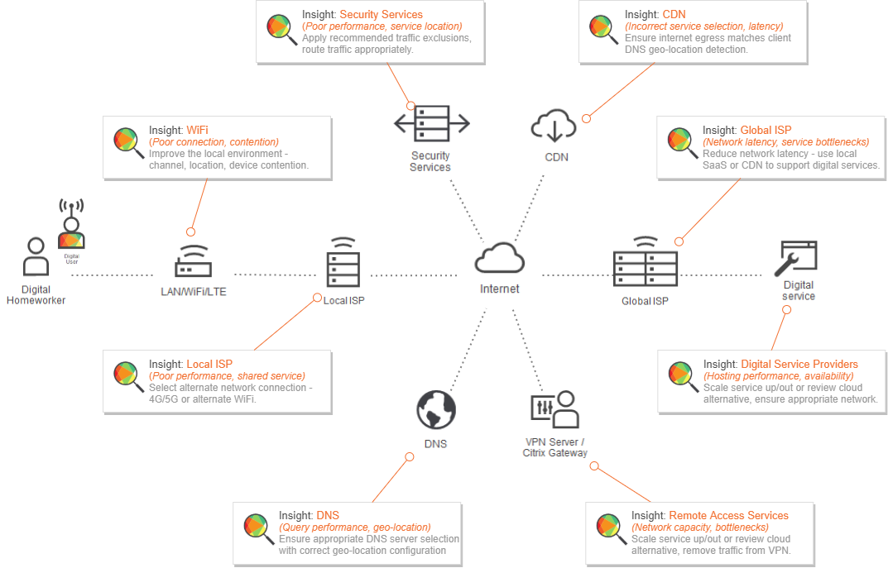
DIGITAL HOMEWORKING
Human Experience Audit
insights

